Slide 1

Facebook Case
Team D In-Person MSBA
Jessica Zhang, David Chen Lee, Jerry Yang,
Himangini Banwari, Michael Chung

Slide 2
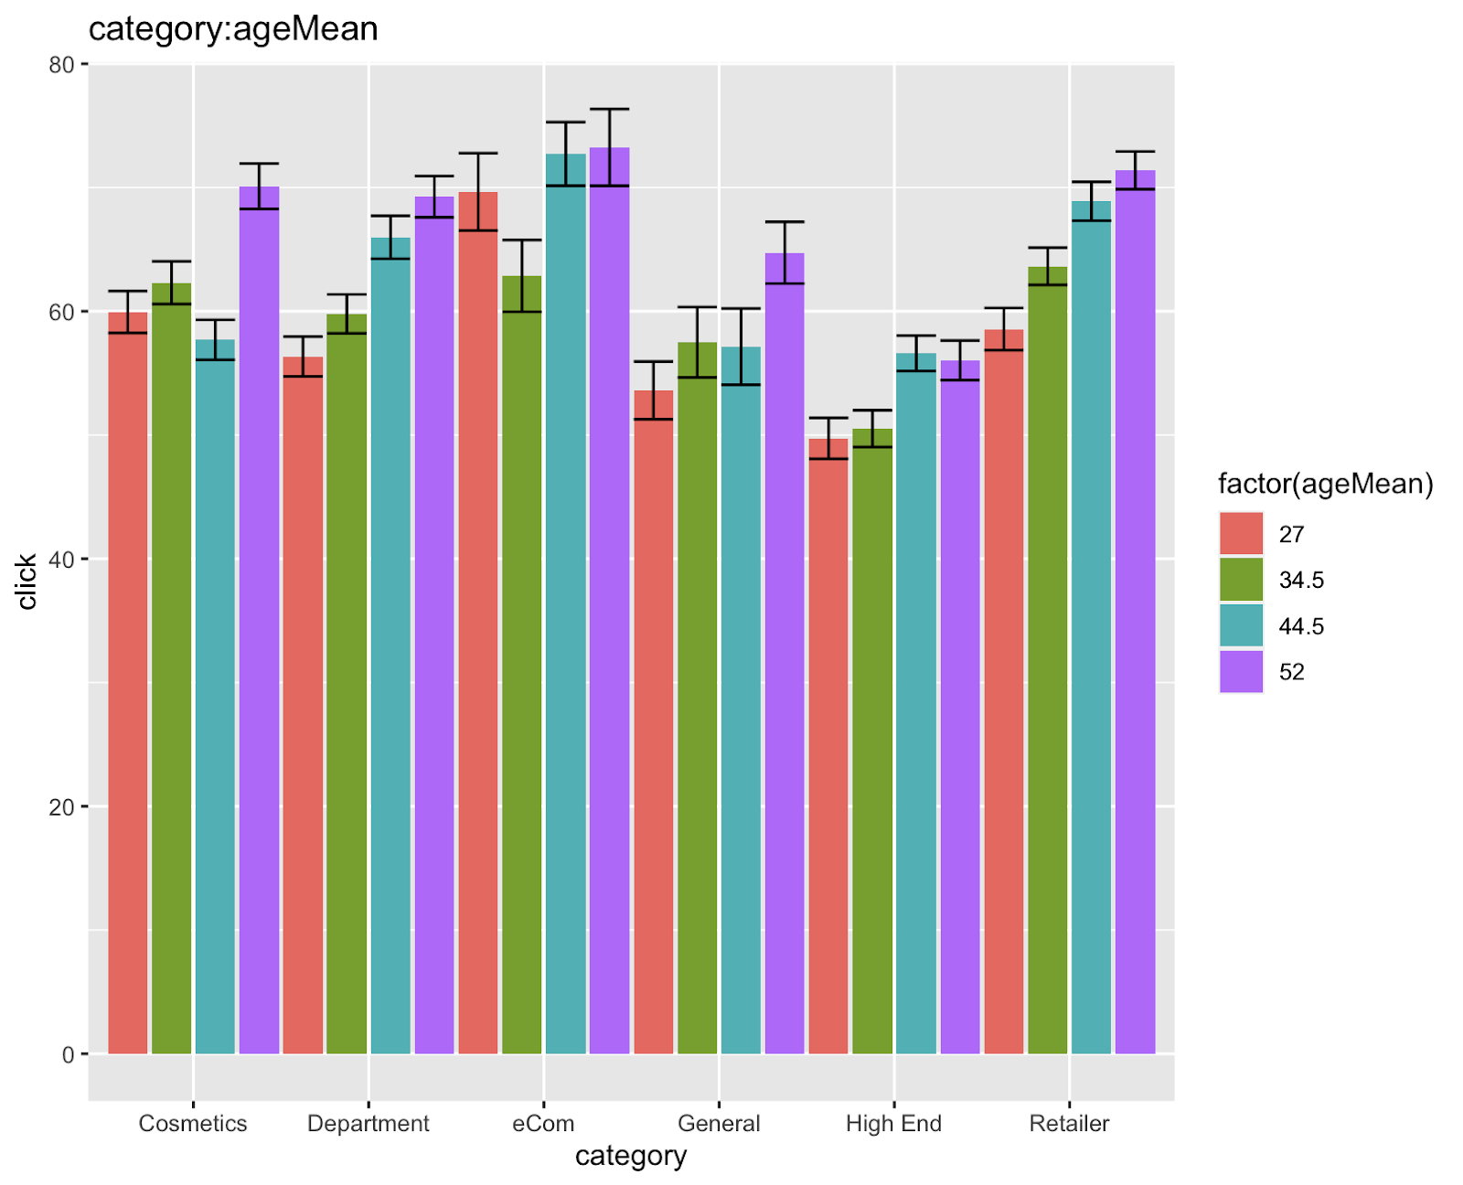
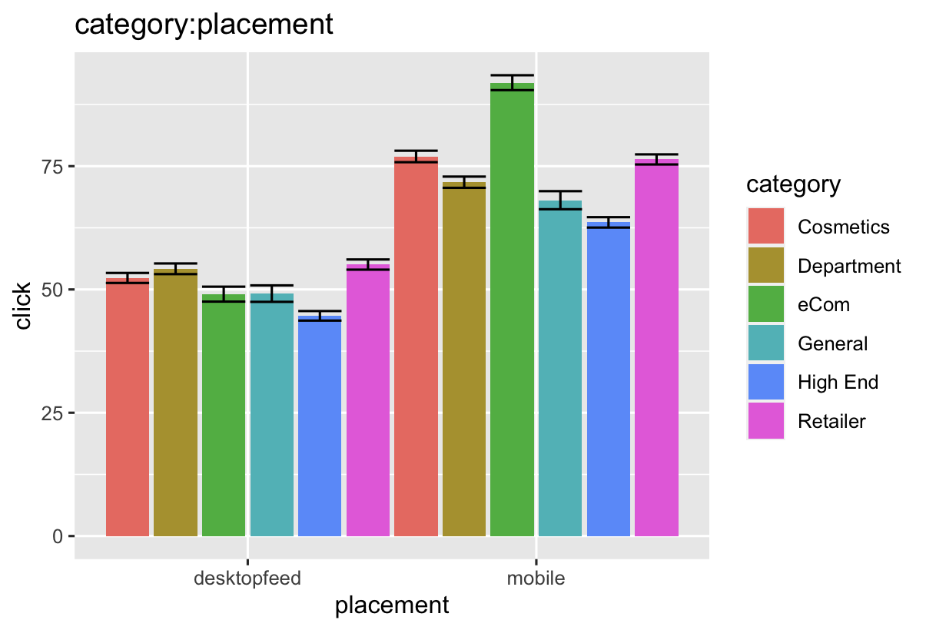
Data Description
Placement on mobile and increase of target age has positive effect on click/dollar

Slide 3
Get the targets by Criteria
Criteria for the targets:
Interesting findings on coefficients:
Score
>
1.1
Large coefficients
Predicted Click Per Dollar
Value Per Click(0.011)
1+%Return on Action(0.1)
· eCom: mobile 20.58823791
· mobile 20.89344097
· Some bodies are extremely productive(over 36): New in spring, Share spring looks
*
Prediction by Regression:
Model
Negative coefficients of interactions
Predict the click per dollar by considering category, ageMean, placement, adType, body
+ interaction variable (category*ageMean) and (category*placement)
· factor(category)eCom: ageMean -0.2335242
· factor(category)General:factor(placement)mobile -1.00888379
Notes:
"Like" to see what's new in our stores for Spring!!
Share your favorite fresh Spring looks on our Facebook page. Click ""Like"" now.
Caompare to the cos category, ecom have less increase by unit of ageMean increase for -0.2335242

Slide 4
The Analysis Result
All successful Ads Placement- Mobile

Slide 5
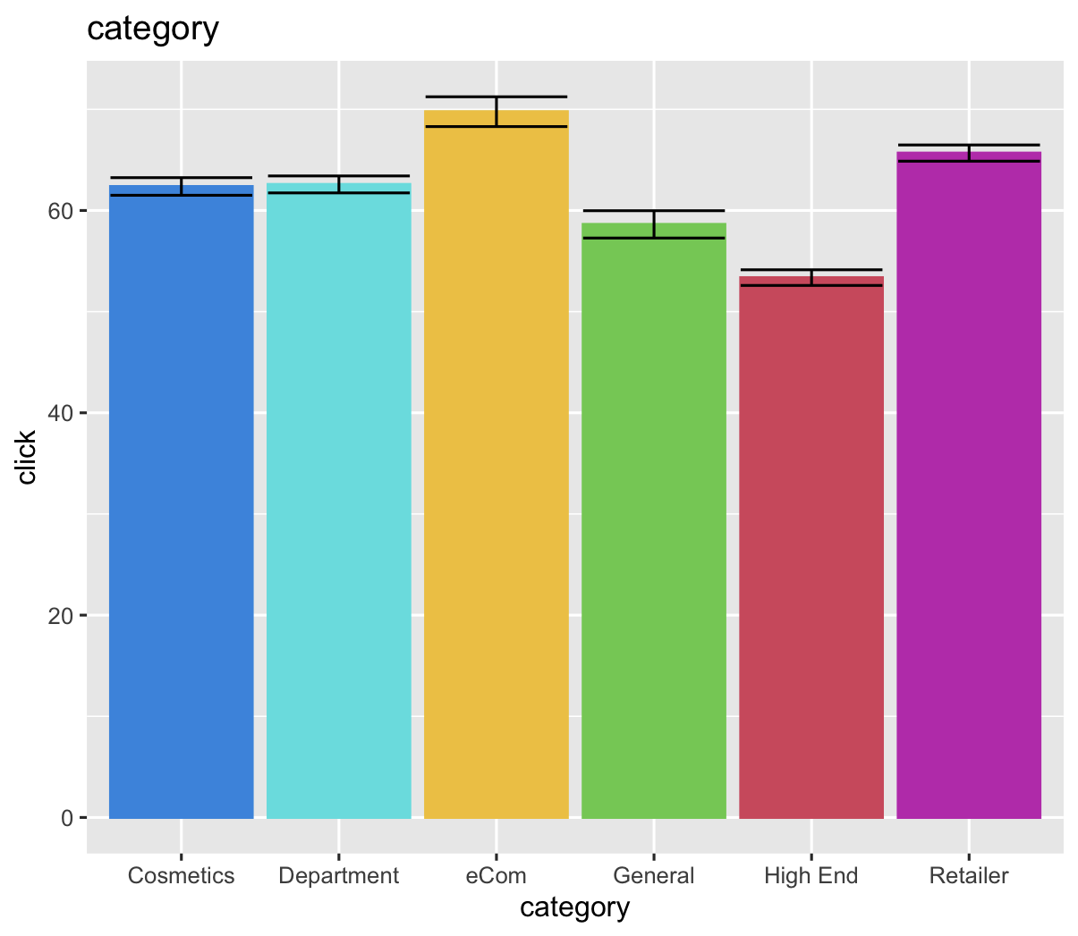
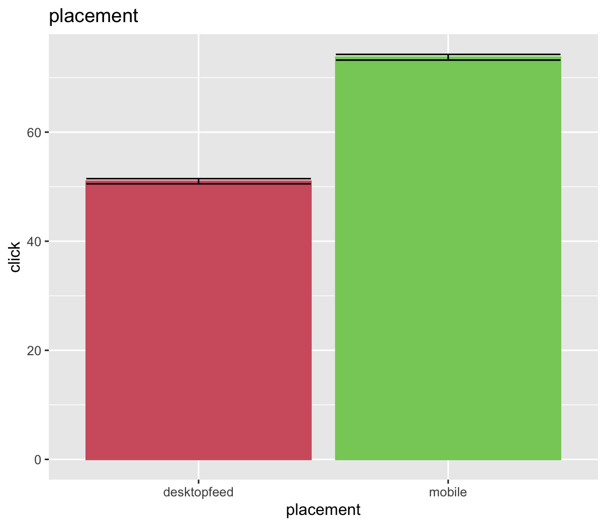
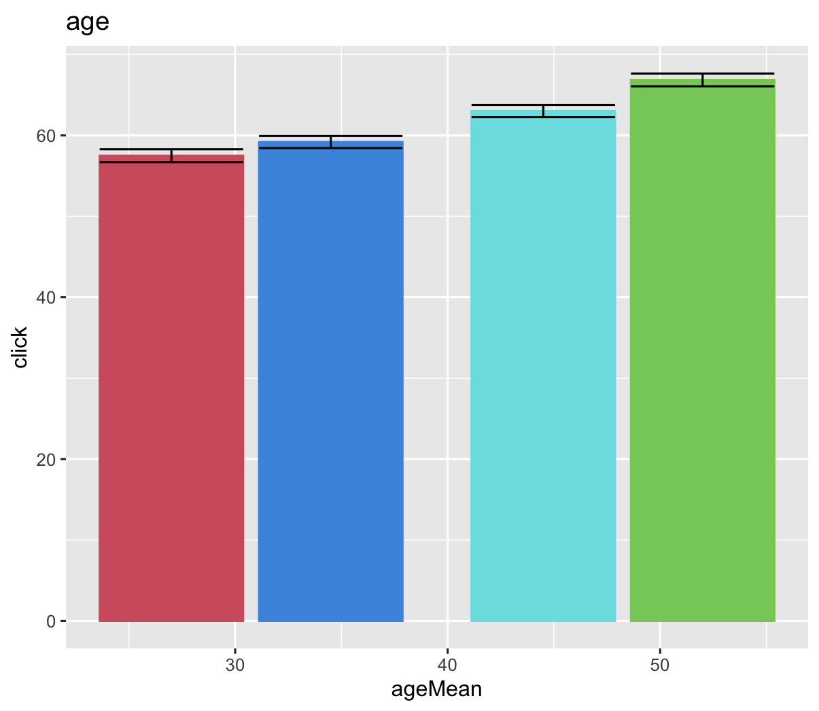
Appendix - Data Description

